Slide 1
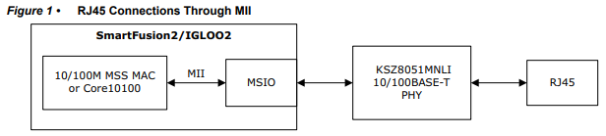
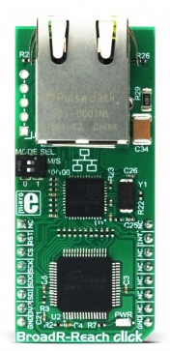
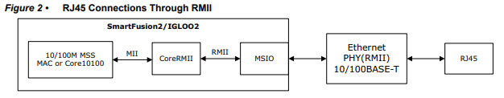
Ethernet Controller
 | Core10100 | OpenCores | MikroE BroadR-Reach Click
LEs |  | 1900 | N/A
Cost | Free* | Free* | $69 ($55)
Speed | 10/100 | 10/100/1000 | 10/100/1000
Interface | AHB/APB | Wishbone | SPI
* Not including RJ45 and PHY
For IGLOO2, Ethernet functionality is achieved by using Core10100 or CoreTSE MAC IP core, an Ethernet PHY, and standard Ethernet interfaces (MII/RMII/GMII/SGMII, 1000BASE-X, XAUI)
Clock rate : 25 MHz
More Signals
Clock rate : 50 MHz
Less Signals
Mikroe BroadR-Reach
Click

